Slide 1

MERN STACK WEB DEVELOPMENT PROJECT
Medibook
A Doctor consultancy appointment booking platform
Patients · doctors · administrators
Notes:
Medibook is a proposed MERN-based hospital doctor appointment platform. This review follows the patient journey, the system architecture, the data model, and the engineering practices that keep the platform dependable as it grows.

Slide 2
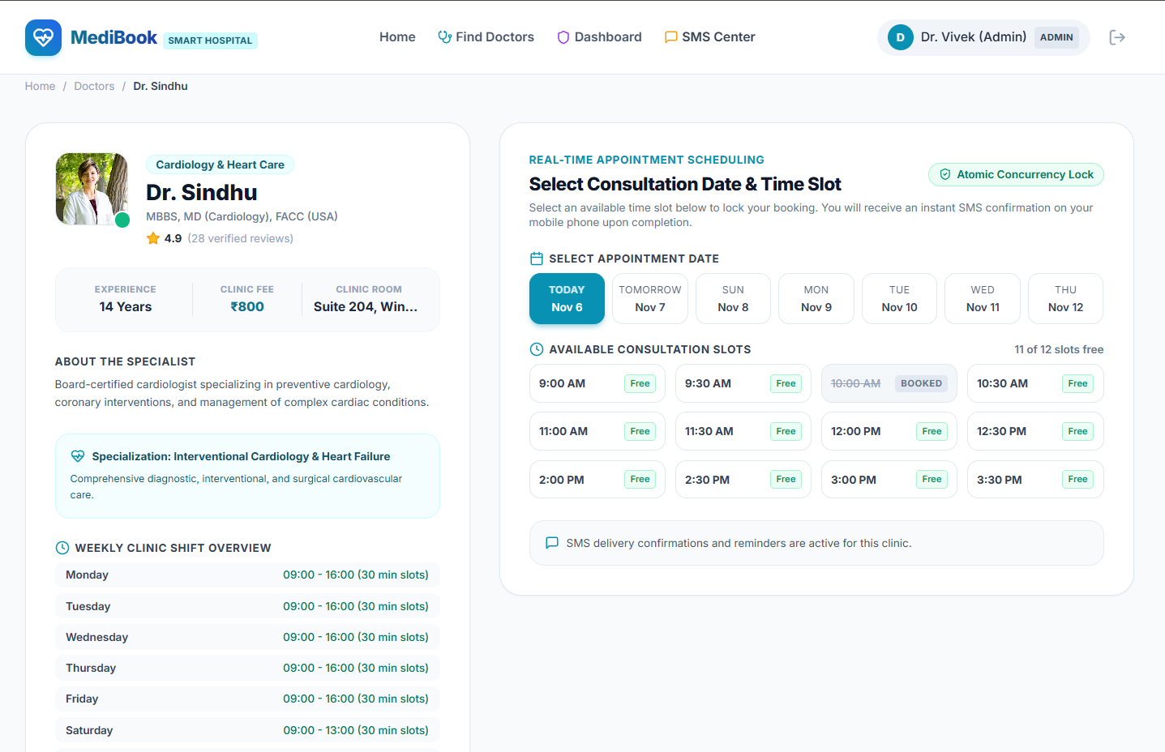
THE PRODUCT PROMISE
Medibook turns appointment friction into a clear digital flow
1
One patient journey
Patients discover doctors, choose a time, and receive booking confirmation in one journey.
2
Structured operations
Doctors and administrators get a structured view of availability and appointments.
Notes:
Start with the product experience. The platform compresses discovery, availability, booking, and confirmation into one understandable path, while operational users see the same appointment system through structured views.

Slide 3




ROLE MODEL
The product is organized around three roles
Patient
Doctor
Admin
Browse doctors, view availability, book, and manage appointments.
Manage profile, schedule, and upcoming appointments.
Oversee users, doctors, schedules, and platform activity.
Notes:
The role model keeps permissions and responsibilities legible. Patients own the booking journey, doctors own their professional availability, and administrators own platform-wide oversight.

Slide 4
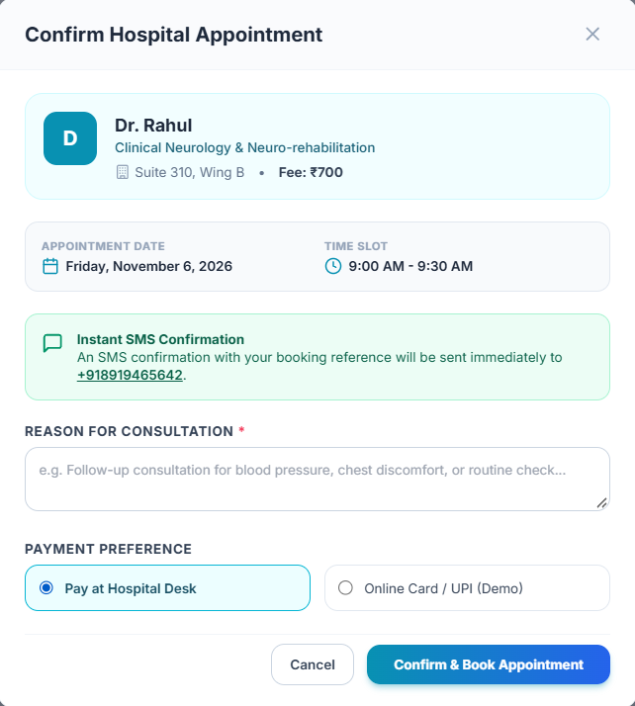
CRITICAL PATH
The booking flow keeps the critical path short
01
02
03
04
Authenticate
Review
Confirm
Manage
Authenticate and select a doctor or specialty.
Review profile details and available time slots.
Confirm the appointment and persist the booking.
View status, history, or cancellation options.
Notes:
Each step has one job. Authentication establishes identity, selection narrows the choice, confirmation persists the booking, and management gives the patient a safe way to review or cancel it later.

Slide 5
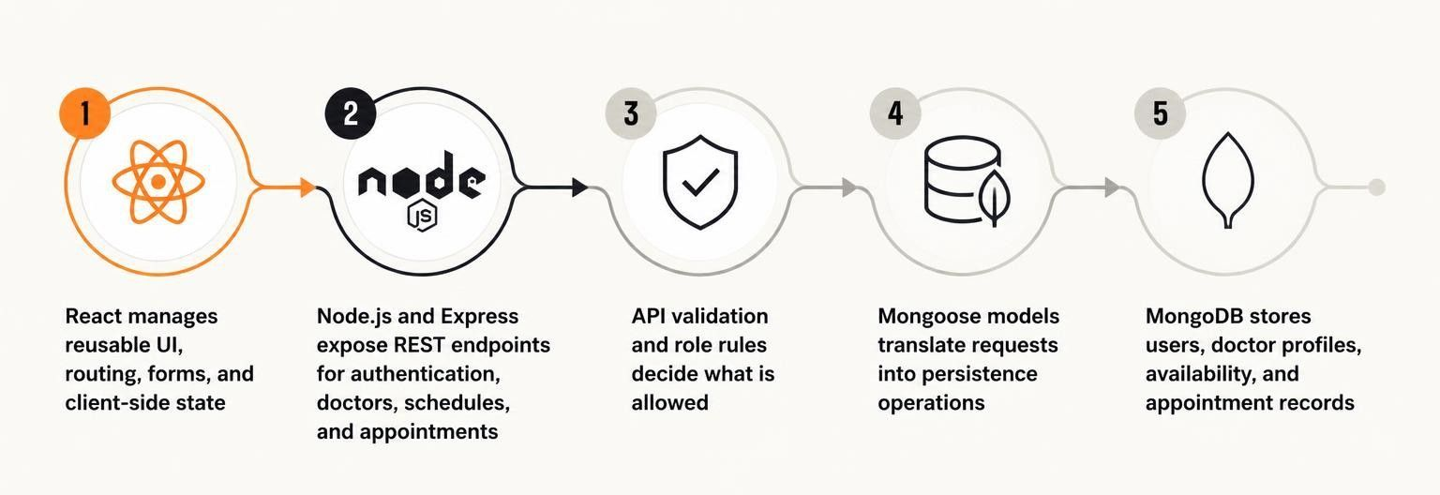
IMPLEMENTATION STORY · PROPOSED
React owns the experience, while the API owns the rules
The client keeps interaction coherent; the server remains the authority for identity, availability, and booking decisions.
Notes:
React is responsible for the experience: reusable components, routes, forms, and client state. Node.js and Express expose the REST boundary, while MongoDB remains behind Mongoose models. The API, not the browser, owns the rules.

Slide 6
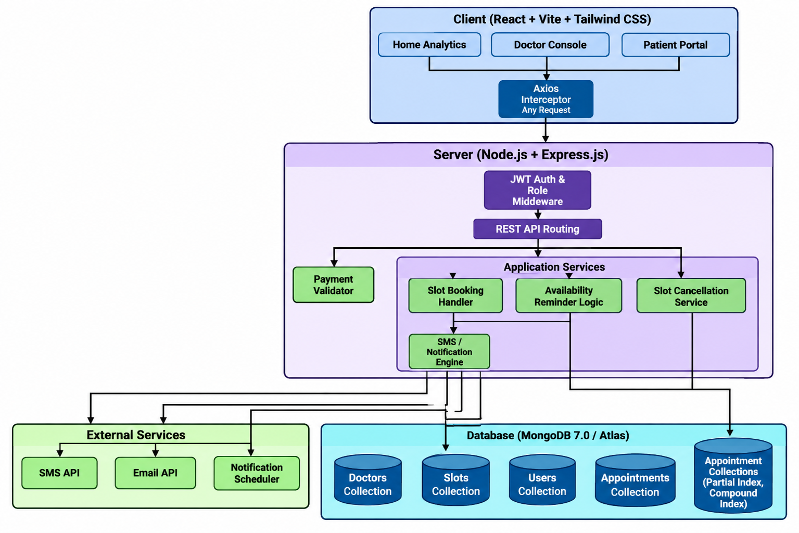
SYSTEM ARCHITECTURE · PROPOSED
The architecture separates interface, logic, and persistence
Clear boundaries make each layer easier to test, replace, and reason about.
Notes:
Read the architecture from left to right. The React client talks to Express routes and controllers. Services and validation hold application logic, Mongoose models isolate data access, and MongoDB persists the records. Authentication and authorization cross the protected route boundary.

Slide 7
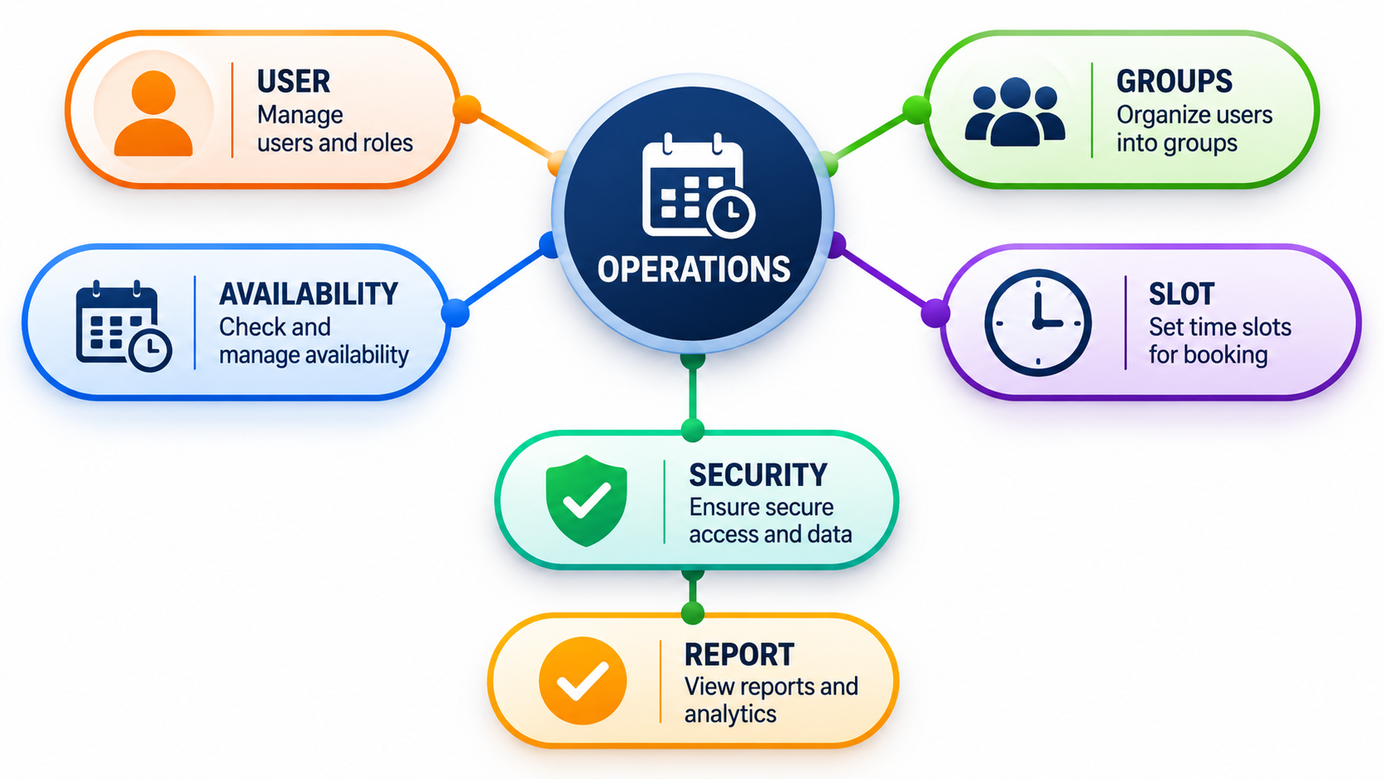
DATA INTEGRITY · PROPOSED
The data model protects the integrity of every booking
Identity, availability, and appointment state connect through explicit references and server-side checks.
Notes:
User and doctor profiles connect identity to role-specific capabilities. Availability defines what can be booked, while an appointment references the patient, doctor, slot, and status. Validation and conflict checks must run before persistence to prevent incomplete or duplicate bookings.

Slide 8
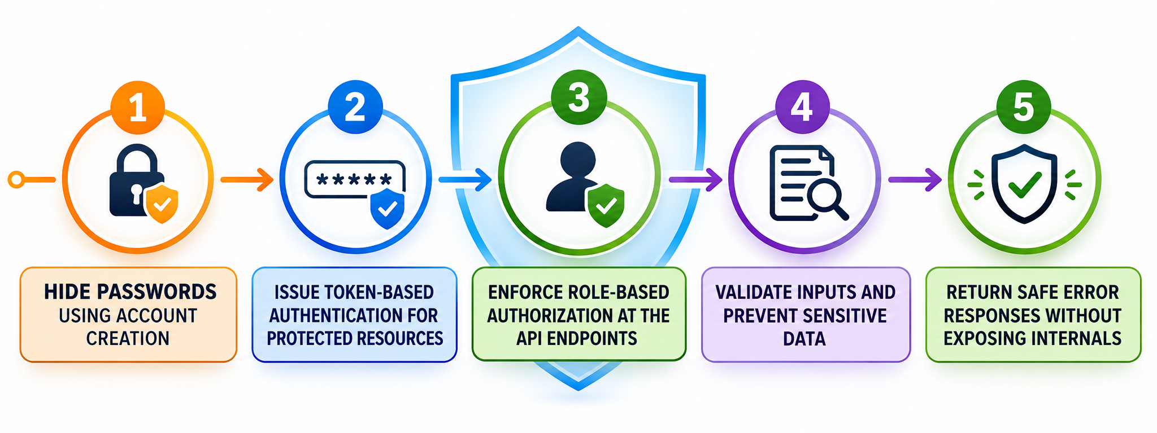
SECURITY BASELINE · PROPOSED
Security is part of the product, not a final checklist
The safest flow is designed into authentication, authorization, validation, and error handling from the first request.
Notes:
Security is a product behavior, not a deployment afterthought. Passwords are hashed, protected sessions use tokens, and role checks happen at the API boundary. Input validation, sensitive-data protection, and safe errors reduce the damage of malformed or unauthorized requests.

Slide 9



MAINTAINABILITY · PROPOSED
A maintainable implementation makes the next feature cheaper
The codebase should make the common path obvious and the risky path testable.
Separate responsibilities
Reuse the interface
Test the edges
Keep routes, controllers, services, models, and middleware distinct.
Share components for forms, doctor cards, slot selection, and status states.
Test booking, authorization rules, and scheduling edge cases.
Notes:
Maintainability is a feature multiplier. Separation keeps changes local, reusable components prevent UI drift, and focused tests protect the booking path and the edge cases most likely to create operational trouble.

Slide 10

NEXT HORIZON
Medibook grows from booking to care coordination
Next: Reminders, doctor search and filters, rescheduling, and admin analytics. Future options: Teleconsultation, payments, reviews, notifications, and audit history.
Principle: Keep the patient journey simple while the platform stays dependable.
Notes:
The platform can expand from booking into coordination without losing its center. Reminders, search, rescheduling, analytics, teleconsultation, payments, reviews, notifications, and audit history are possible next layers. The engineering principle stays constant: simple for patients, dependable underneath.

